Slide 1
Outline
Introduction
Description of FILE pointer
categories of files
text and binary files
Creating a Sequential Access File

Slide 2
Introduction
Storage of data in variables and arrays is temporary
  such data is lost when a program terminates.
Files are used for permanent retention of data.
  Computers store files on secondary storage devices, especially disk storage devices.
Data files
  Can be created, updated, and processed by C programs
  Are used for permanent storage of large amounts of data

Slide 3
Categories of File
Sequential-access files:
  In this if we want to read the last record of file then we need to read all the records before that record. It means if we want to read 10th record then the first 9 records should be read sequentially for reaching to the 10th record.
Random-access files:
  In this data can be read and modified randomly. If we want to read the last record of the file, we can read it directly. It takes less time as compared as sequential file.

Slide 4
Types of files
Text files:
  Text files are human readable files.
  They are universal and can be edited with many different programs such as NOTEPAD.
  contains ASCII codes only.
  they can only read or write data one character at a time that is sequentially.
Binary files:
  Binary files are not human readable.
  They contain information encoded into the numbers which make up the file which are ultimately turned into ones and zeros, thus the name “binary.”
  Binary files can be either processed sequentially or randomly.

Slide 5
File pointer
Before using a file in a program, we must open it, which establishes a link between the program and the operating system. A file must be defined as:-
FILE *cfPtr;
structure file pointer
where FILE is the data structure which is included in the header file, stdio.h
and cfPtr is declared as a pointer which contains the address of a character which is to be read.

Slide 6
Creating a Sequential Access File
C imposes no structure on a file
  notions such as a record of a file do not exist as part of the C language
  Programmer must provide file structure
Creating a File
  FILE *cfPtr;
    Creates a FILE pointer called cfPtr
  cfPtr = fopen(“clients.dat", “w”);
    Function fopen returns a FILE pointer to file specified
    Takes two arguments – file to open and file open mode

Slide 7
fopen()
fopen is a function which contains two arguments:-
  File name to open
  Mode in which we want to open the file.
    Both these are of string types.
  cfPtr = fopen(“clients.dat", “w”);
Here
  cfPtr = file pointer
  fopen= function to open a file
  clients.doc = name of the file
  w = mode in which file is to be opened
If open fails, NULL returned

Slide 8
fopen():-
This function loads the file from disk to memory and stores the address of the first character to be read in the pointer variable fp.
If file is absent,it returns a NULL pointer variable.
fclose(fp):- the file which is opened need to be closed and only can be done by library function fclose.

Slide 9
#include<stdio.h>
void main()
{
FILE *fp;
fp=fopen(“data.txt”,”r”);
if(fp == NULL)
{
printf(“cannot open file”);
}
getch();
}

Slide 10
Closing a file
To reopen it in some other mode
To prevent any misuse with the file
To make the operations you have performed on the files successful.
To close a file, we must use function fclose()
Syntax:
int fclose(FILE *stream);

Slide 11
fclose()
It closes the named stream. We can pass pointer variable that points to a file to be closed. All buffers associated with the stream are flushed before closing.
On success, fclose() returns 0 otherwise, it
returns end of function (EOF).

Slide 12
#include<stdio.h>
#include<conio.h>
void main()
{
FILE *fptr;
fptr=fopen("a.txt",“w");
if(fptr==null)
printf("\n file cannot be opened for creation");
else
printf("\n file created successfully");
fclose(fptr);
}

Slide 13
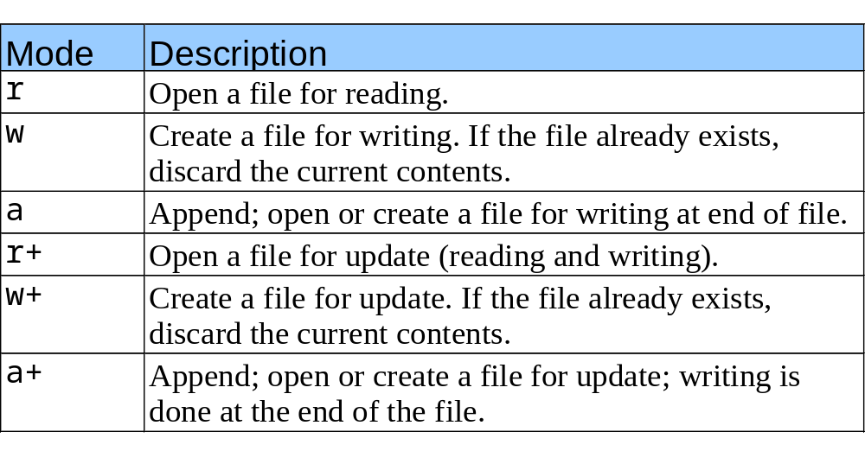
Creating a Sequential Access File
File opening modes used with fopen()
If you are going to handle binary files then you will use below mentioned access modes instead of the above mentioned:
"rb", "wb", "ab", "ab+“, "wb+", rb+"

Slide 14
Creating a Sequential Access File
fprintf
  Used to print to a file
  Like printf, except first argument is a FILE pointer (pointer to the file you want to print in)
fprintf (cfPtr, "%d \n“,rollno);
feof( FILE pointer )
  Returns true if end-of-file indicator (no more data to process) is set for the specified file
fclose( FILE pointer )
    Closes specified file
    Performed automatically when program ends
    Good practice to close files explicitly

Slide 15
Creating a Sequential Access File
Details
  Programs may process no files, one file, or many files
  Each file must have a unique name and should have its own pointer

Slide 16
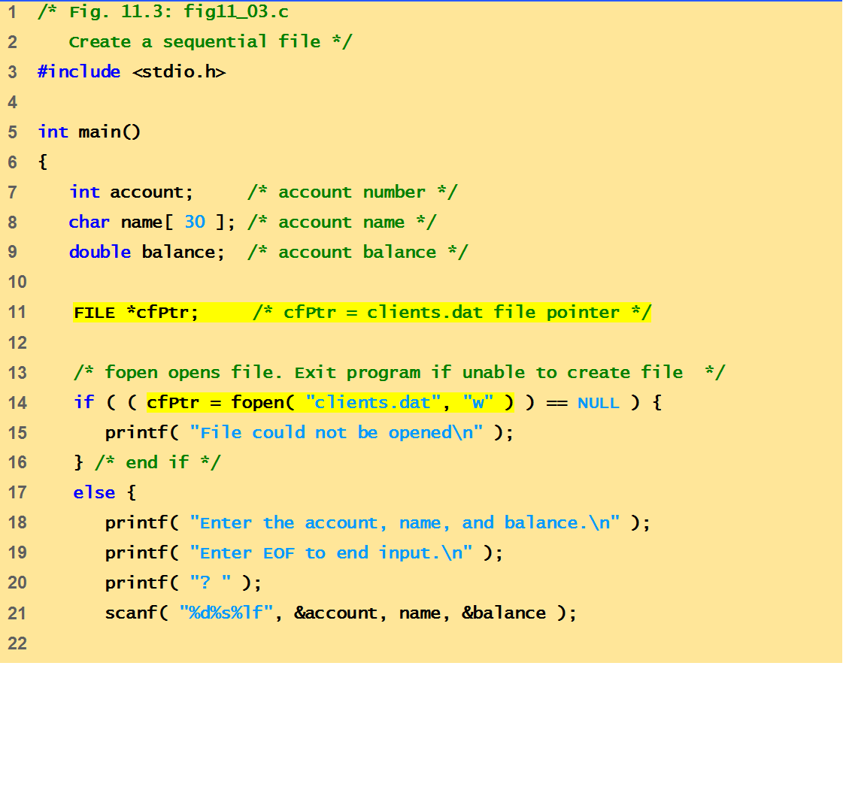
Example Code (writing into a file )
This program demonstrates opening, writing and closing the file

Slide 17
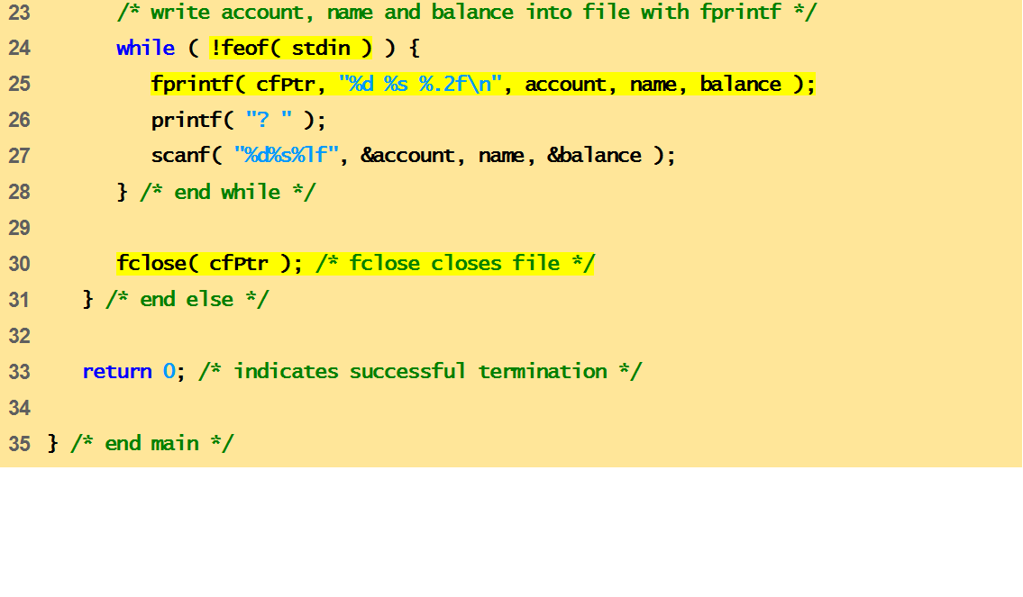
Example Code (writing into a file )
This program demonstrates opening, writing and closing the file
Enter the account, name, and balance.
Enter EOF to end input.
? 100 Jones 24.98
? 200 Doe 345.67
? 300 White 0.00
? 400 Stone -42.16
? 500 Rich 224.62
? ^Z
output

Slide 18
Outline
Reading Data from a Sequential Access File
Reading, Writing and Appending files

Slide 19
File read/write function
Read/Write functions in standard library
  fgetc
    Reads one character from a file
    Takes a FILE pointer as an argument
    fgetc( stdin ) equivalent to getchar()
  fputc
    Writes one character to a file
    Takes a FILE pointer and a character to write as an argument
    fputc( 'a', stdout ) equivalent to putchar( 'a' )

Slide 20
File read/write function
  fgets
    Reads a line from a file
  fputs
    Writes a line to a file
  fscanf / fprintf
    File processing equivalents of scanf and printf

Slide 21
Binary modes:-
wb(write):-it opens a binary file in write mode.
fp=fopen(“data.dat”,”wb”);
Here data.dat file is opened in binary mode for writing.
rb(read):-it opens a binary file in read mode.
fp=fopen(“data.dat”,”rb”);
Here data.dat file is opened in binary mode for reading.

Slide 22
EOF:-END OF FILE
EOF is an integer value sent to prog.by OS. it’s value is predefined to be -1 in STDIO.H,
No char with the same value is stored on disk. while creating file, OS detects that last character to file has been sent, it transmits EOF signal.

Slide 23
Reading from a file
Different functions to read a char are fgetc and getc. Both perform similar functions and have the same syntax.
ch = fgetc (fp);
char type function file pointer
variable name
fgets() or gets():-used to read strings from a file and copy string to a memory location which is referenced by array.
fgets(str, n, fptr);
array of chars max length file pointer

Slide 24
Writing chars to a file
fputc() or putc():-both these functions write the character in the file at the position specified by pointer.
putc (c, fp);
function character file pointer
type variable
The file pointer automatically moves 1 position forward after printing characters in the file.

Slide 25
#include<conio.h>
#include<stdio.h>
void main()
{
FILE *fptr;
char ch;
clrscr();
fptr=fopen(“Myfile.txt","w");
printf("Enter the line of text,press 0 to stop ");
/*read the text from user using getche() function upto user inserts 0 as input and put them into the file
*/
while( (ch=getche()) !=0)
{
putc(ch,fptr);//put into file
}
fclose(fptr);//close the file
}
Write char into file using putc()

Slide 26
#include<conio.h>
void main()
{
FILE *fptr;
char ch;
clrscr();
fptr=fopen(“Myfile.txt","r");
printf("the line of text is");
/*read the text from file using getc() function upto EOF and put them on the screen
*/
while( (ch=getc(fptr)) !=EOF)
{
printf("%c",ch);
}
fclose(fptr);
getch();
}
Read each character from file using getc() and prints them

Slide 27
Void main( )
{
    FILE *fptr;
    char ch;
    fptr=fopen(“Myfile.txt”,”r”);
    if(fptr == NULL)
    printf(“file doesn’t exist”);
    else
    {
    while((ch=fgetc(fptr))!=EOF)
    printf(“%c”,ch);
    }
    fclose(fptr);
}
Program to understand use of fgetc()

Slide 28
fscanf( ):- it is used to read to any type of variable i.e.,char,int,float,string
fscanf(fp,”%c”,&ch);
file pointer control char type
string variable
fscanf(fp,”%c%d%f”,&a,&b,&c);
We write stdin, this func call will work similar to simple scanf
Because stdin means standard i/p i.e.keyboard.
fscanf(stdin,”%c”,&ch);
Is equivalent to
scanf(“%c”,&ch);

Slide 29
#include<conio.h>
void main()
{
FILE *fptr;
char name[10];
int sal;
fptr=fopen(“rec.dat”,”r”);
fscanf(fptr,”%s%d”,name,&sal);
while(!feof(fptr))
{
printf(“%s%d”,name,sal);
fscanf(fptr,”%s%d”,name,&sal);
}
fclose(fptr);
getch();
}
Notes:
This routines test whether end of file is reached on a stream or not. It returns non zero value when eof indicator is detected on the last read operation otherwise it returns zero . The syntax is
Int feof(FILE *stream);

Slide 30
fprintf():- it is used to print chars,numbers or strings in a file.
fprintf (fp,“%d”,a);
With this function,we can print a no. of variables with single call.
fprintf (fp,”%c %d %d”,a,b,c);
We write stdout,this func call will work similar simple printf
Because stdout means standard o/p i.e.keyboard.
fprintf(stdout,”%c”,ch);
Is equivalent to
printf(“%c”,ch);

Slide 31
main()
{
FILE *fp;
char name[10];
fp=fopen(“rec.dat”,”w”);
printf(“enter your name”);
scanf(“%s”,name);
fprintf(fp,”%s”,name);
fclose(fp);
}

Slide 32
Sequential Access File
Reading a sequential access file
  Create a FILE pointer, link it to the file to read
    File *cfPtr;
    cfPtr = fopen( “clients.dat", "r" );
  Use fscanf to read from the file
    Like scanf, except first argument is a FILE pointer
    fscanf( cfPtr, "%d", &rollno );

Slide 33
File Position Pointer
  Data read from beginning to end
  File position pointer
    Indicates number of next byte to be read / write.
    Not really a pointer, but an integer value (specifies byte location)
    Also called byte offset
  rewind( cfPtr )
    Repositions file position pointer to beginning of file (byte 0)

Slide 34
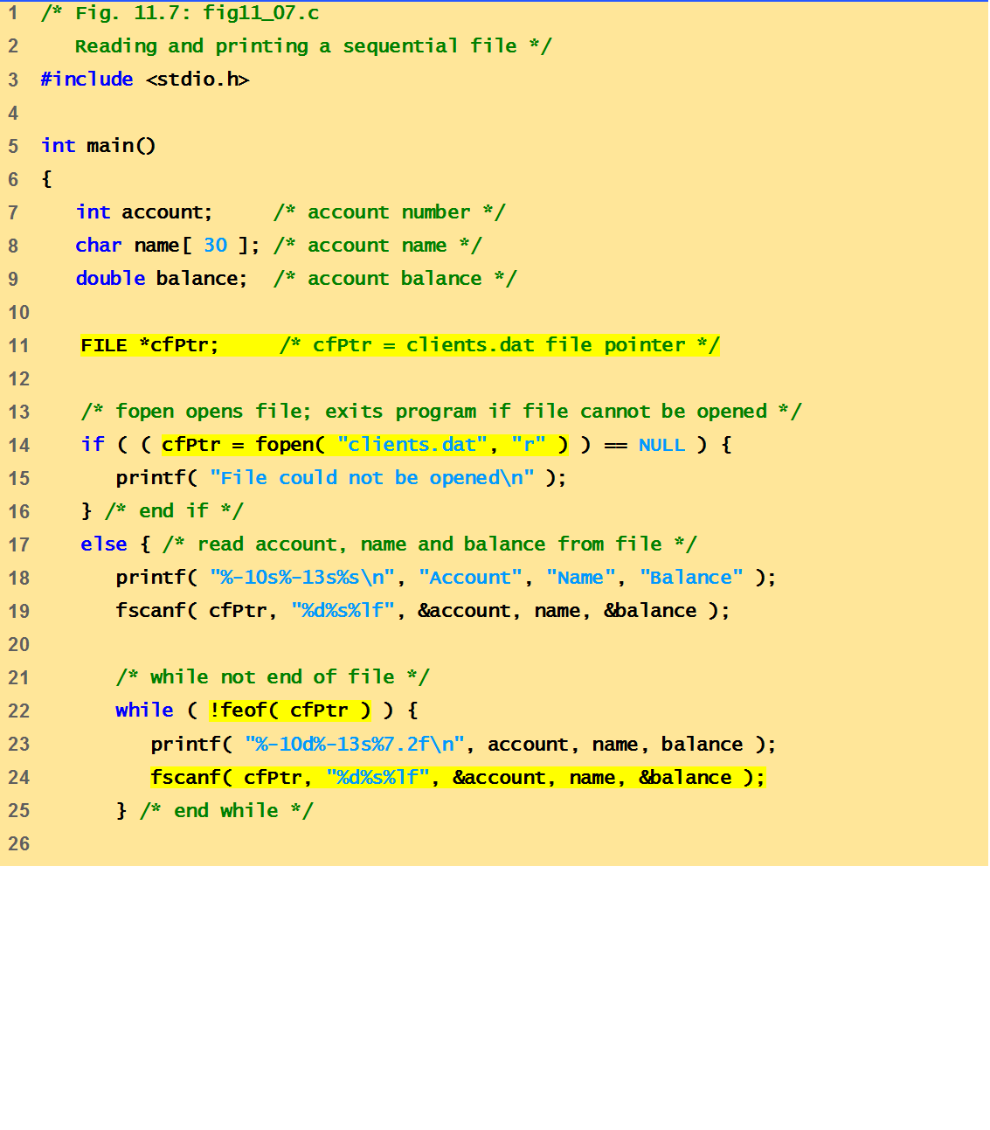
Example Code
This program demonstrates reading the content of sequential file and printing it

Slide 35
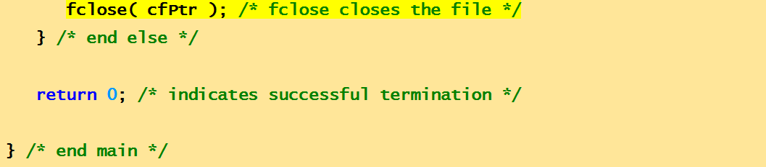
Example Code
This program demonstrates opening, writing and closing the file
Account Name Balance
100 Jones 24.98
200 Doe 345.67
300 White 0.00
400 Stone -42.16
500 Rich 224.62
output

Slide 36
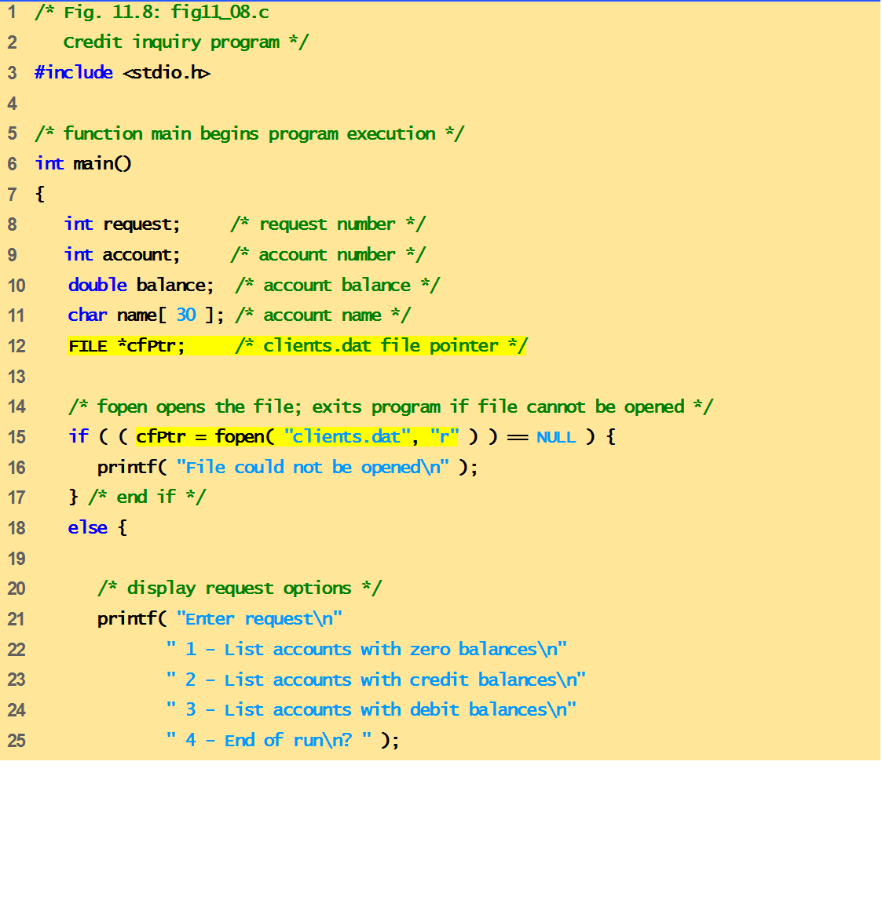
Example Code
This program demonstrates conditional reading from a sequential file

Slide 37
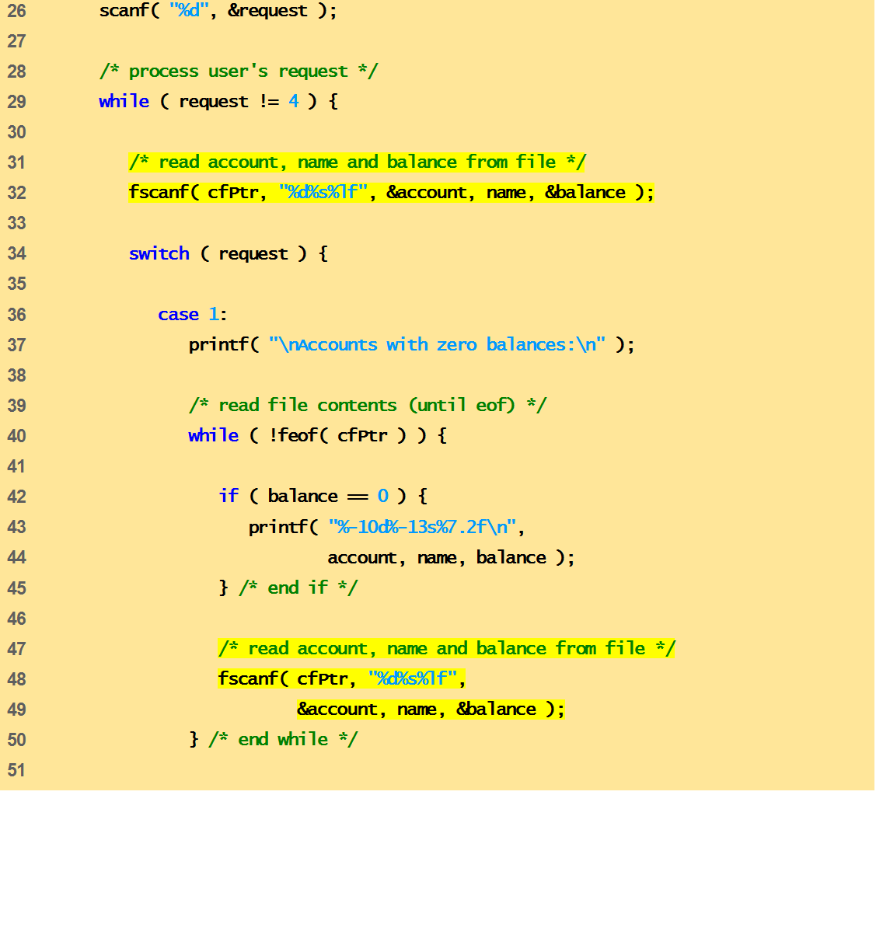
Example Code
This program demonstrates conditional reading from a sequential file

Slide 38
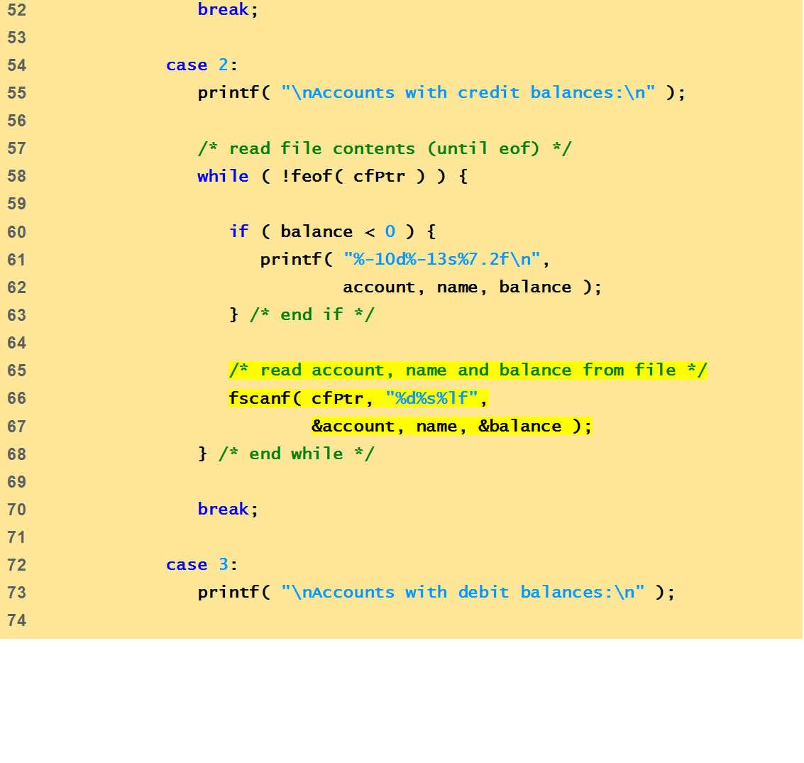
Example Code
This program demonstrates conditional reading from a sequential file

Slide 39
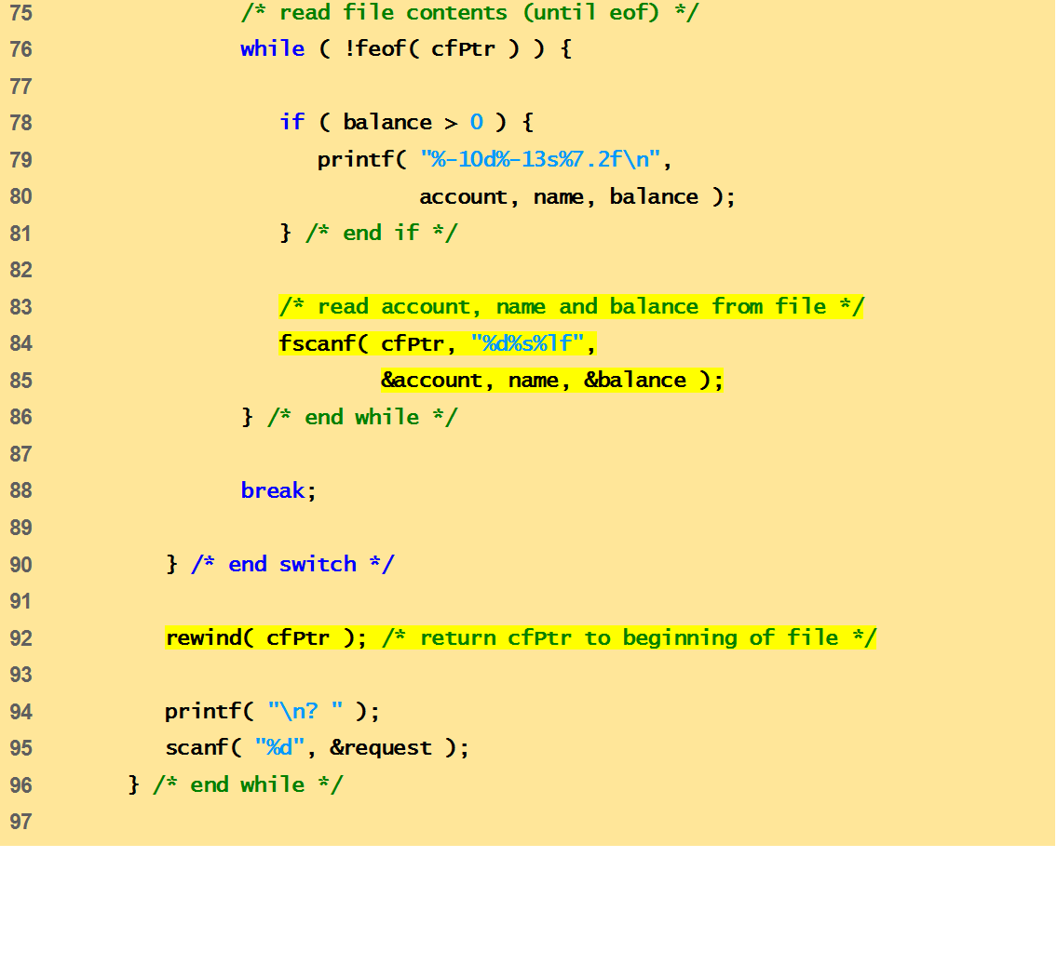
Example Code
This program demonstrates conditional reading from a sequential file

Slide 40
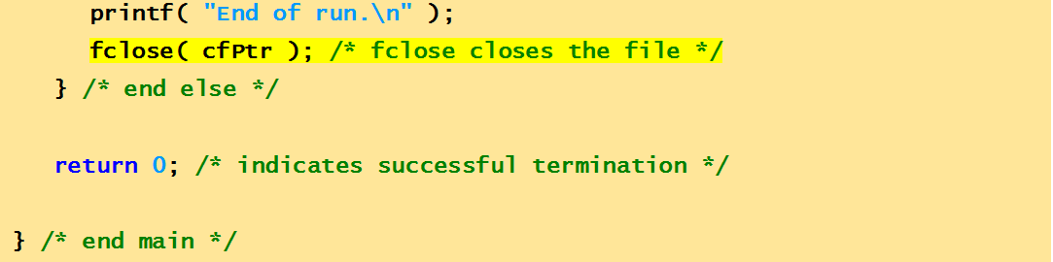
Example Code
This program demonstrates conditional reading from a sequential file

Slide 41
Output
Enter request
1 - List accounts with zero balances
2 - List accounts with credit balances
3 - List accounts with debit balances
4 - End of run
? 1
Accounts with zero balances:
300 White 0.00
? 2
Accounts with credit balances:
400 Stone -42.16
? 3
Accounts with debit balances:
100 Jones 24.98
200 Doe 345.67
500 Rich 224.62
? 4
End of run.

Slide 42
Output
Enter request
1 - List accounts with zero balances
2 - List accounts with credit balances
3 - List accounts with debit balances
4 - End of run
? 1
Accounts with zero balances:
300 White 0.00
? 2
Accounts with credit balances:
400 Stone -42.16
? 3
Accounts with debit balances:
100 Jones 24.98
200 Doe 345.67
500 Rich 224.62
? 4
End of run.

Slide 43
Output
Enter request
1 - List accounts with zero balances
2 - List accounts with credit balances
3 - List accounts with debit balances
4 - End of run
? 1
Accounts with zero balances:
300 White 0.00
? 2
Accounts with credit balances:
400 Stone -42.16
? 3
Accounts with debit balances:
100 Jones 24.98
200 Doe 345.67
500 Rich 224.62
? 4
End of run.

Slide 44
Output
Enter request
1 - List accounts with zero balances
2 - List accounts with credit balances
3 - List accounts with debit balances
4 - End of run
? 1
Accounts with zero balances:
300 White 0.00
? 2
Accounts with credit balances:
400 Stone -42.16
? 3
Accounts with debit balances:
100 Jones 24.98
200 Doe 345.67
500 Rich 224.62
? 4
End of run.

Slide 45
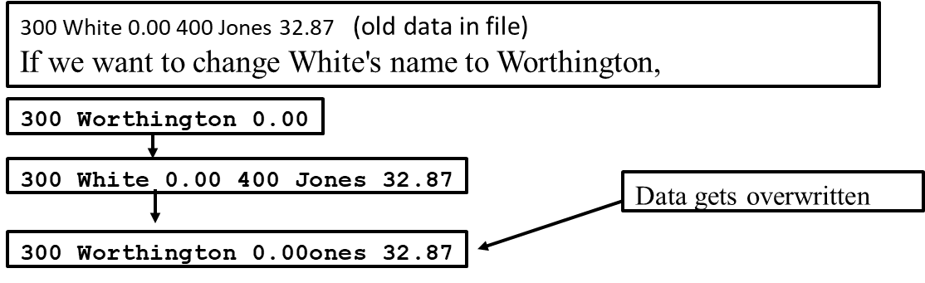
Drawbacks of Sequential Access File
Sequential access file
  Cannot be modified without the risk of destroying other data
  Fields can vary in size
    Different representation in files and screen than internal representation
    1, 34, -890 are all ints, but have different sizes on disk

